Slide 1

Module 13: CMOS cell layout 1
OHIO UNIVERSITY – SCHOOL OF EECS – EE5143 – DIGITAL DESIGN WITH VHDL AND VSLI

Slide 2
CMOS layout
Going from circuit to real physical implementation
A CMOS circuit, whether simple or complex, is needed for design and simulation purposes but in order to make it as a physical device we need another step called ‘layout’.
Layout is the process of laying out the circuit as an interconnection between real physical devices on a silicon chip. The interconnections between the terminals of various transistors constitute the actual physical circuit. This interconnection is realized on a chip through conducting tracks of either polysilicon (highly doped and metal-like conducting silicon) or a metal like aluminum. In practice, polysilicon or metal is uniformly deposited everywhere on the chip (blanket deposition) and then etched to form the desired interconnection (wiring) pattern. Photomasks are used for defining this interconnection pattern to be etched into the blanket polysilicon (or metal) film.

Slide 3
CMOS layout
Going from circuit to real physical implementation
The first (bottom-most) layer on a silicon chip consists of MOSFETs. Each transistor’s source, drain and gate contacts are available at this layer. Next comes the first wiring layer where polysilicon tracks connect gates of various transistors and metal tracks make other connections. Thereafter, there may be several individual wiring planes, separated from each other by inter-metal dielectric (IMD) layers (usually consisting of deposited silicon dioxide). The interconnection tracks in these various layers were usually made from blanket deposited and then dry etched aluminum. In more recent ICs copper has replaced aluminum as the interconnection track material because its lower resistivity results in lower parasitic resistances compared to aluminum.
The process of defining the interconnection pattern to form a physical circuit in silicon is called IC layout.

Slide 4
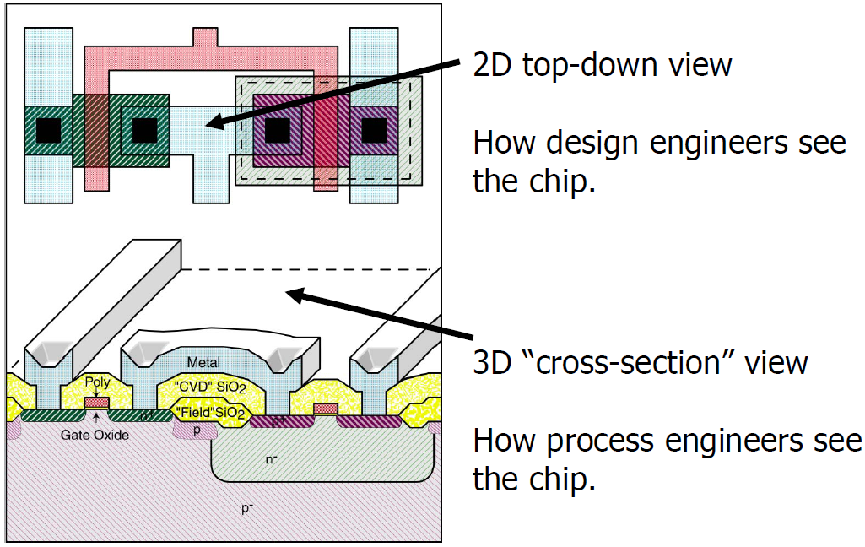
CMOS layout
Designer’s view versus device engineer’s (technologist’s) view
IC design engineers think and work in terms of top-down 2D layouts
IC process engineers think and work in terms of 3D cross-sections

Slide 5
CMOS layout
Going from circuit to real physical implementation
Although the work of design and process engineers is different their interface comes through design rules that dictate the various geometries and dimensions for circuit layout.
There are a number of these design rules such as, width rule, space rule, overlap rule etc.
The design rules may be given in absolute units or in scalable units. In the first case the geometries are fixed at layout times and are not altered later on whereas in the second case only a parameter is used for dimensions and this parameter may be scaled as needed later on to fit the design to different geometries.

Slide 6
CMOS layout
Scalable design rules
CMOS scaling
􀁠Implement something now, shrink it later
􀁠Express all design rules in terms of a unit dimension
􀁠Change the actual dimension of the unit, and the whole design shrinks
􀂄Unit dimension: Minimum line width(2λ)
􀁠In 1978, λ = 1.5 μm (a.k.a. 3 micron technology)
􀁠In 2003, λ = 0.065 μm (a.k.a. 0.13 micron technology)
􀁠In 2014, λ = 90 nm (a.k.a. 45 nm technology)

Slide 7
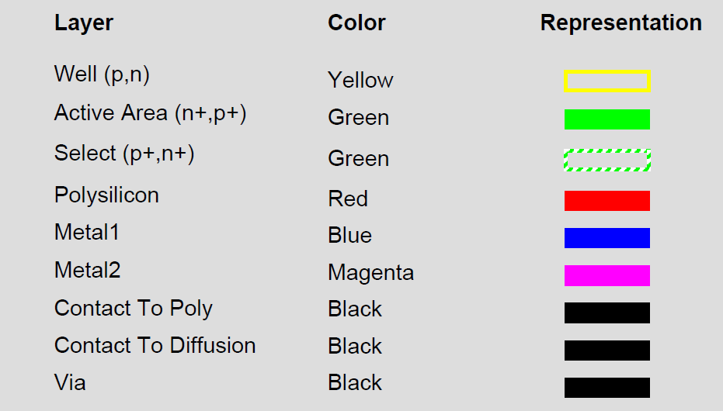
CMOS layout
Color-coded CMOS layers

Slide 8
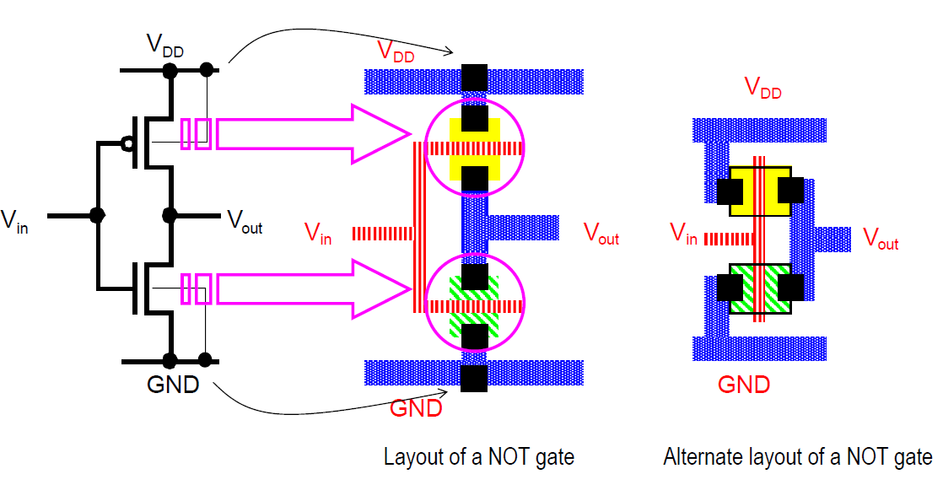
CMOS layout
CMOS inverter (NOT gate) layout

Slide 9
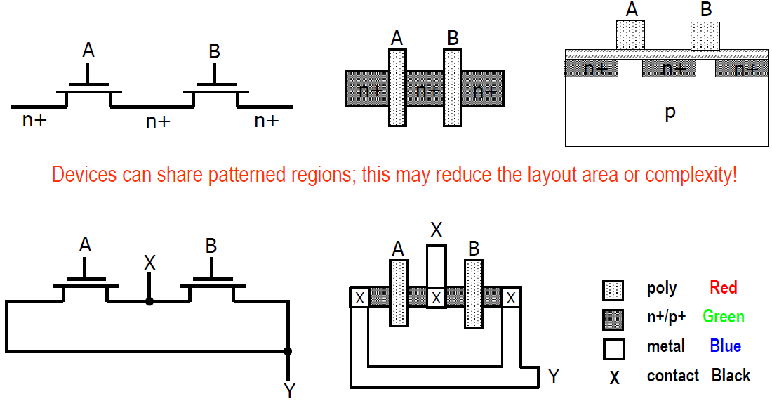
CMOS layout
Sharing patterned area between devices

Slide 10
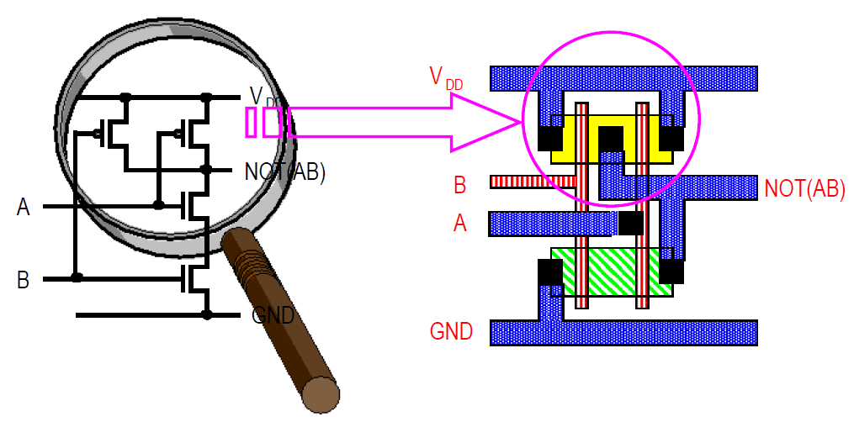
CMOS layout
CMOS NAND gate layout

Slide 11
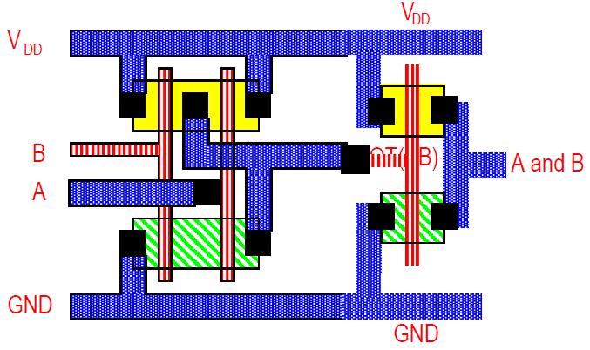
CMOS layout
CMOS 2-input AND gate layout

Slide 12
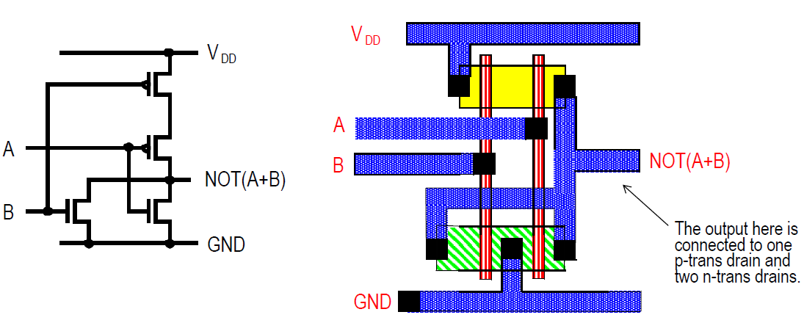
CMOS layout
CMOS NOR gate layout

Slide 13
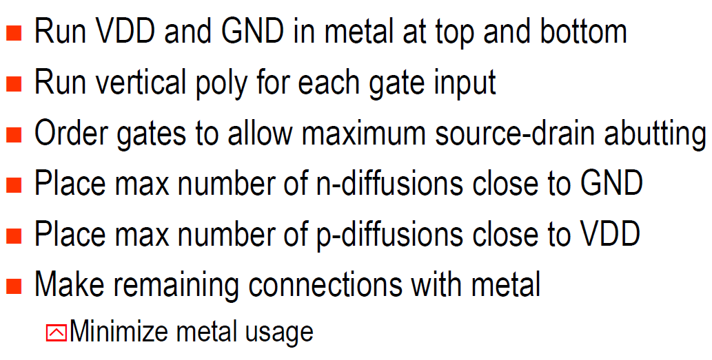
CMOS layout
Gate design procedure

